Slide 1
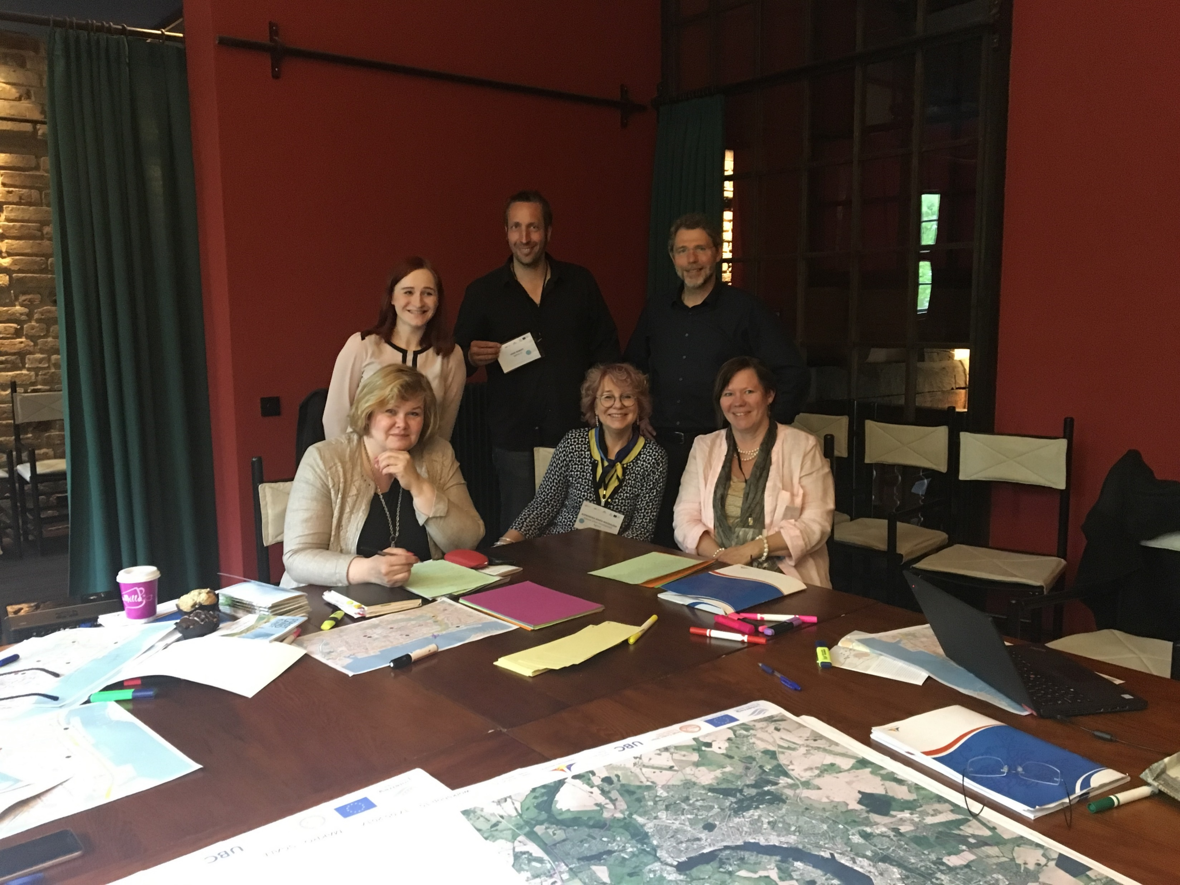
GROUP BLUE – MESO SCALE – INNER CITY AND ENTIRE OLD HARBOR
AREA ECONOMIC DEVELOPMENT
Sirpa, Helsinki
Natalia, Gdansk
Maria, Gdansk
Niels-Peter, Aarhus
Lena, Oskarshamn
And more … Robert, Rostock (moderator)

Slide 3
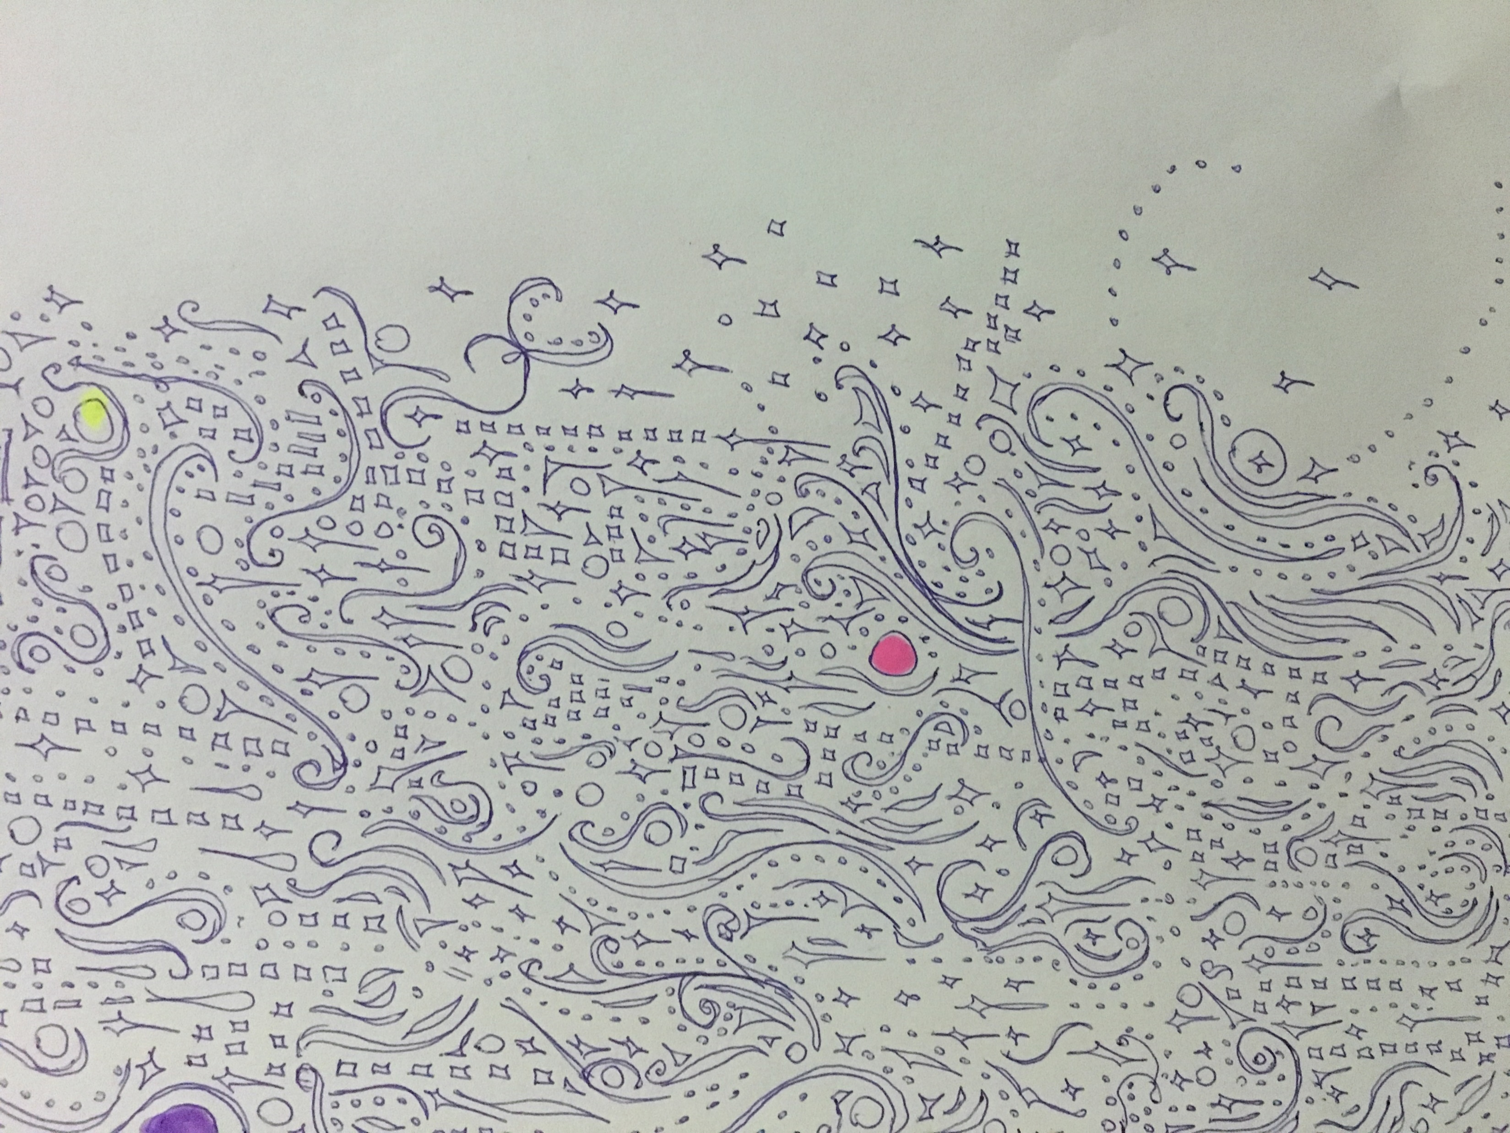
FIRST IMPRESSION AND DEBATE
So much beauty
So much traffic
So many cars
So much emptiness
So much potential!

Slide 4
SWOT– ANALYSIS
Strengths
Weaknesses
Opportunities
Threats
… in relation to ensure economic development
In the inner city and the old harbor area.

Slide 5
STRENGTHS
University – possibility to attract young talented people
Fairly stable growth
Economical activities are good
Different clusters in the business life
There are activities - Festivals, Hansa Sail, culture.
The scale of inner city is very comfortable – human size
Well done fill-inn projects – beside the church, the music school
Small distance between the inner city and the old harbor area

Slide 6
WEAKNESSES
Bad contact to the other side of the river
Bad connections between the inner city and the harbor and water front
Too much traffic on Am Strande – makes a terrible barrier
Too much parking on the surface at the harbor area
Bad bicycle conditions
Lack of activities between Lange Strasse and Am Strande – no signs
Rostock is not visible on the internet – or in the mind of people outside MV.
The marketing is missing.
The uniqueness is not discovered. What is the present soul of Rostock?
The hanseatic image needs a new face
Nobody knows about all the activities that goes on
Lack of parking policy, lack of visible values and guide-lines
Lack of participation programs
Difficult to come to Rostock – takes a whole day …

Slide 7
OPPORTUNITIES
Integrate the harbor area with the inner city
Improve connections – dig a tunnel, build bridge, lower the speed of the traffic
Develop the land for all year around use – mixed use.
Pool the cost -build the world’s most flexible culture house for the museums that are under discussion, the theater, make space for start-ups in the creative sector etc.
Make 1.000 underground parking places and make an attractive public space.
Build housing and business
Improve the city for pedestrians and bicycles.
Go on with the Hansa Sail without all ”the tivoli-stuff”.
Invite the small cruise liners (but don’t allow a fenced area).
Share cost with the companies with Aida, business, the government, the city – all stakeholders
Make a recreational connection to the right bank of the river.
Develop the business area on the right bank
Make the harbor area a liveable place – 24/7/365 for all Rostockers and guests.

Slide 8
THREATS
The harbor stays like it is because of bad leadership/no initiatives
Rostock will loose the competition to more engaged cities
Only growth based on old un-productive people and the service sector
No real innovation, too few new jobs
The small cruise ships project will delay the more important development
The ships won’t come
Or the tourist will still go to Berlin because Rostock is not attractive.
No money to maintain the inner harbor and neglecting the dredging of the river -> Hansa Sail will be without tall ships.
Femer Belt
Climate change

Slide 9
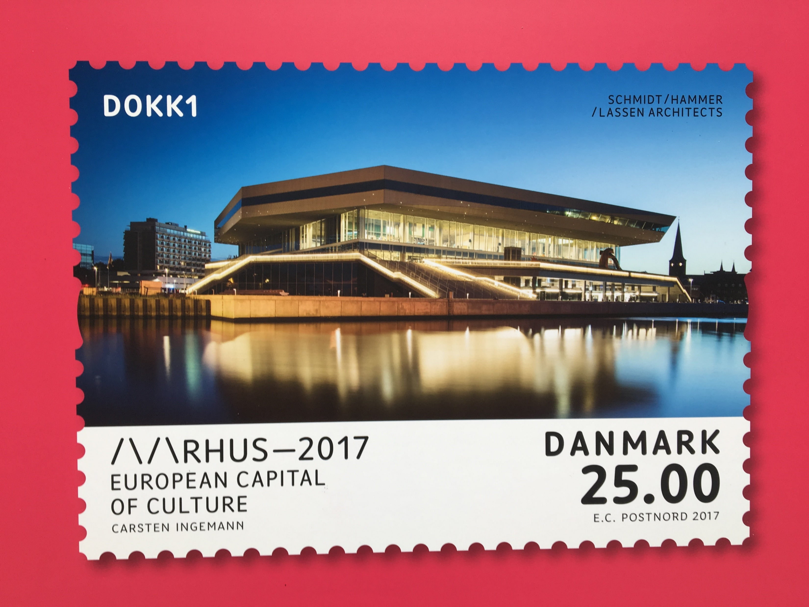
RECOMMENDATIONS
Make the inner city, the harbor area and Rostock in general more attractive for young people and for families/children – normal income groups
Expand the university and the co-operation between the university, the business life and the city
Think big
Build a multifunctional public space/building
Build a mixed housing and business area
Build 1.000 underground parking lots
Involve the citizens/users in making the program
Improve the connection between the harbor and the inner city
Put Am Strande in a tunnel or do something else very radical to the traffic
Invite the small cruise liners to use the normal kays
Go one with Hansa Sail without the ”land side”.

Slide 10
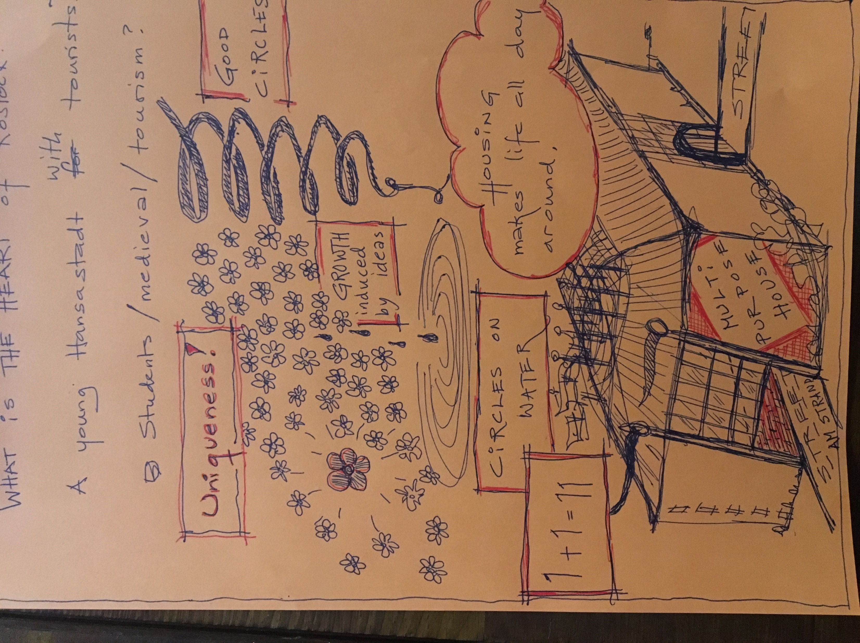
Thank you for your attention!

